Slide 1
Spring Smarties
Three Act Task

Slide 2
Act One

Slide 4
Act Two
85
Jenny’s original starting amount
10 10 10 10 10 10 10 10 5
4
The amount Matt took away
5
19
5
5

Slide 5
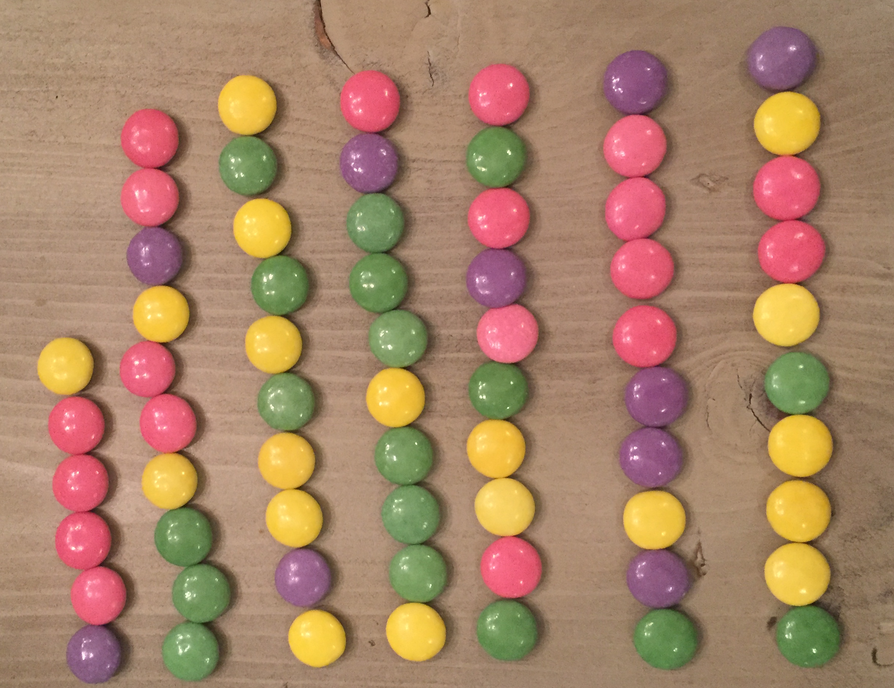
Act Three
66
Jenny’s had this amount left after Matt took
some away.
6 10 10 10 10 10 10

