Slide 1
Estimation Clipboard Pom Poms
Created by Jen Barker
Inspired by Steve Wyborney’s work

Slide 2
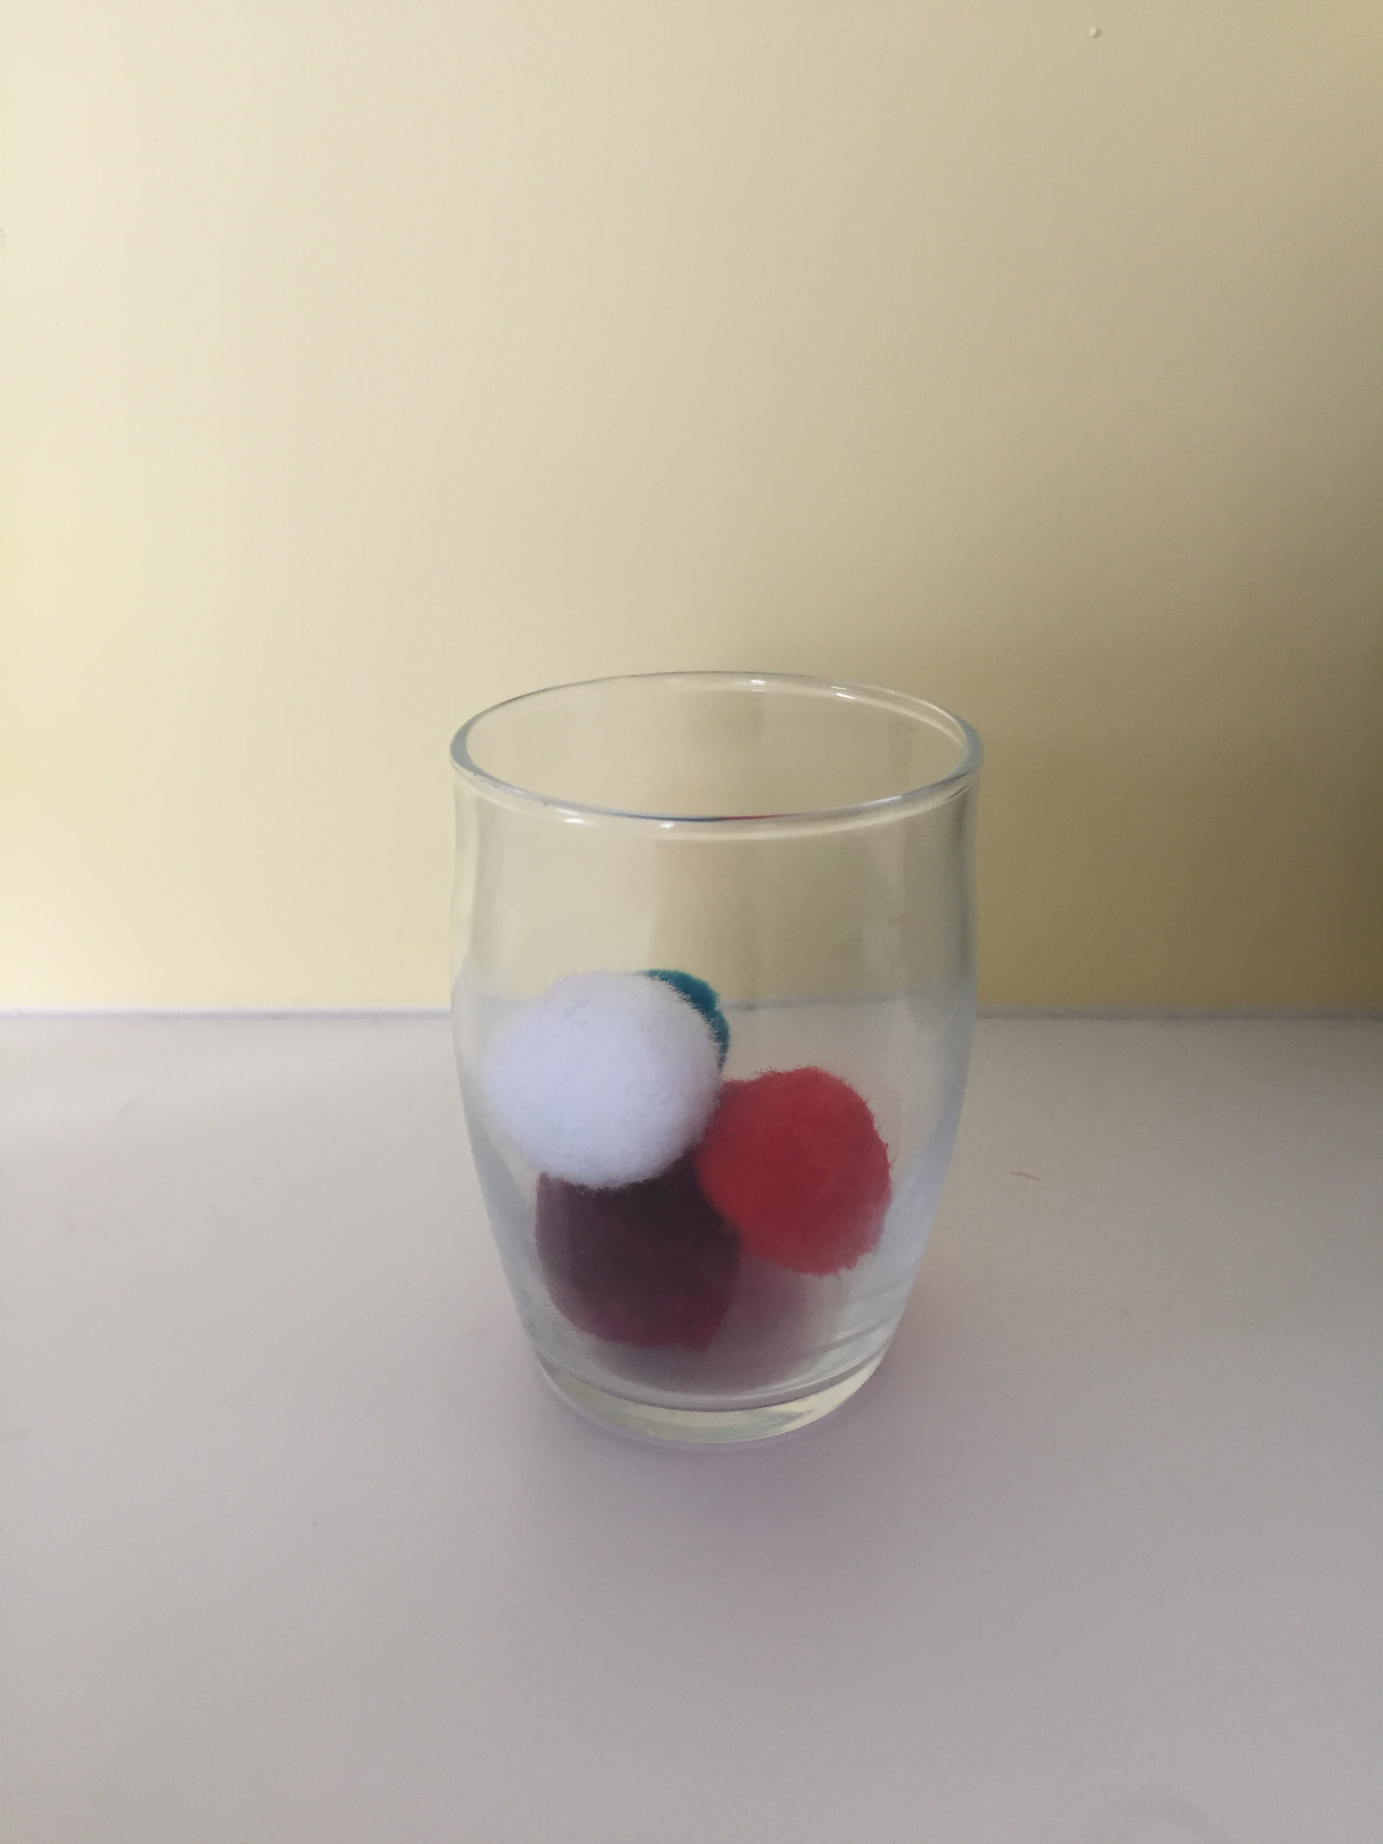
How many pom poms are in the glass jar?
The Reveal

Slide 3
5

Slide 4
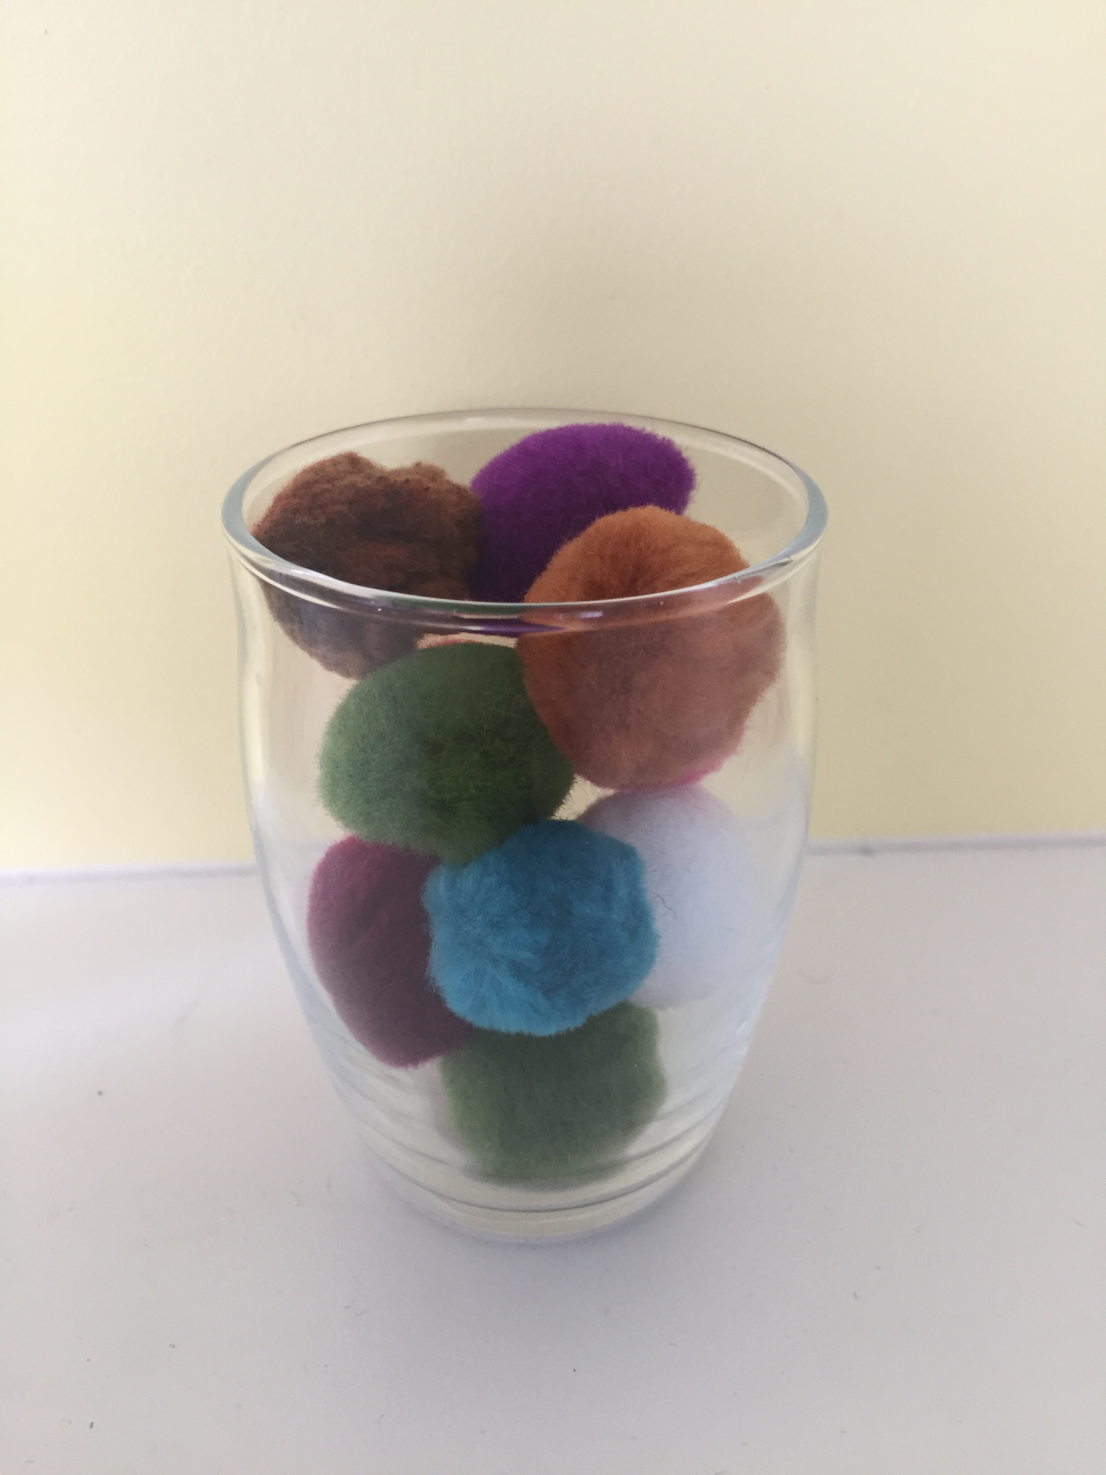
5
The Reveal

Slide 5
5
11

Slide 6
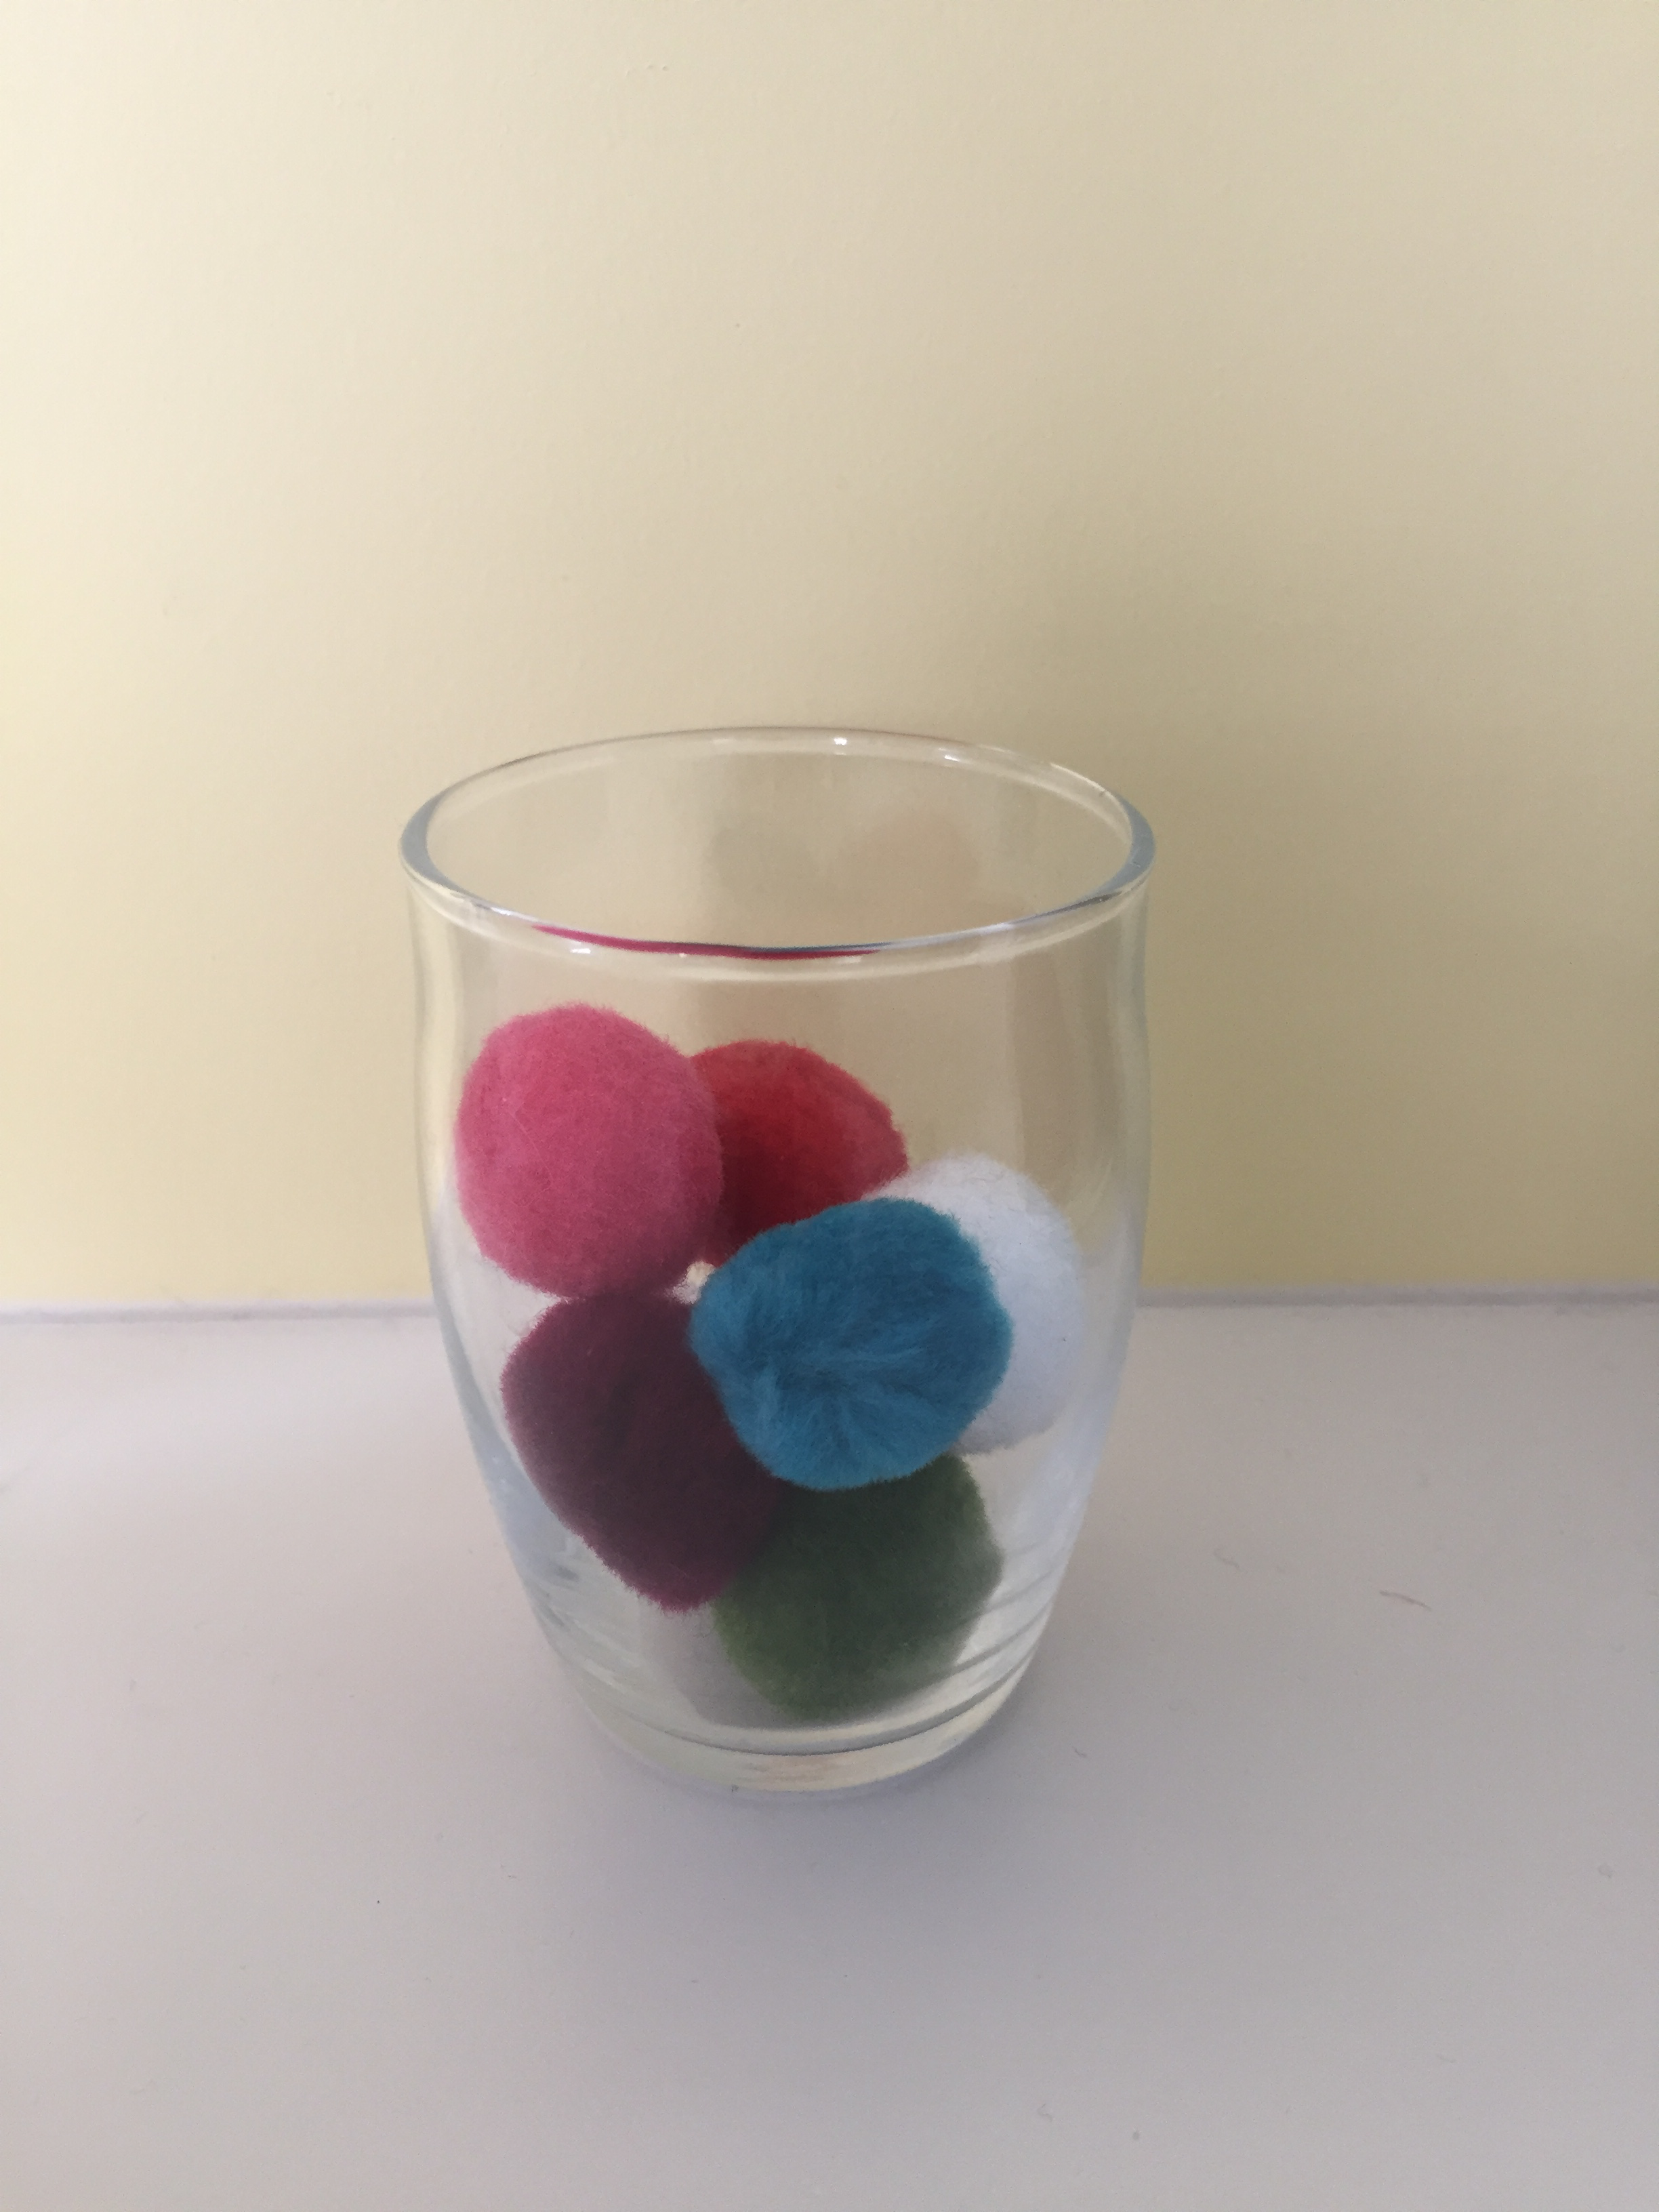
5
11
The Reveal

Slide 7
5
11
7

Slide 8
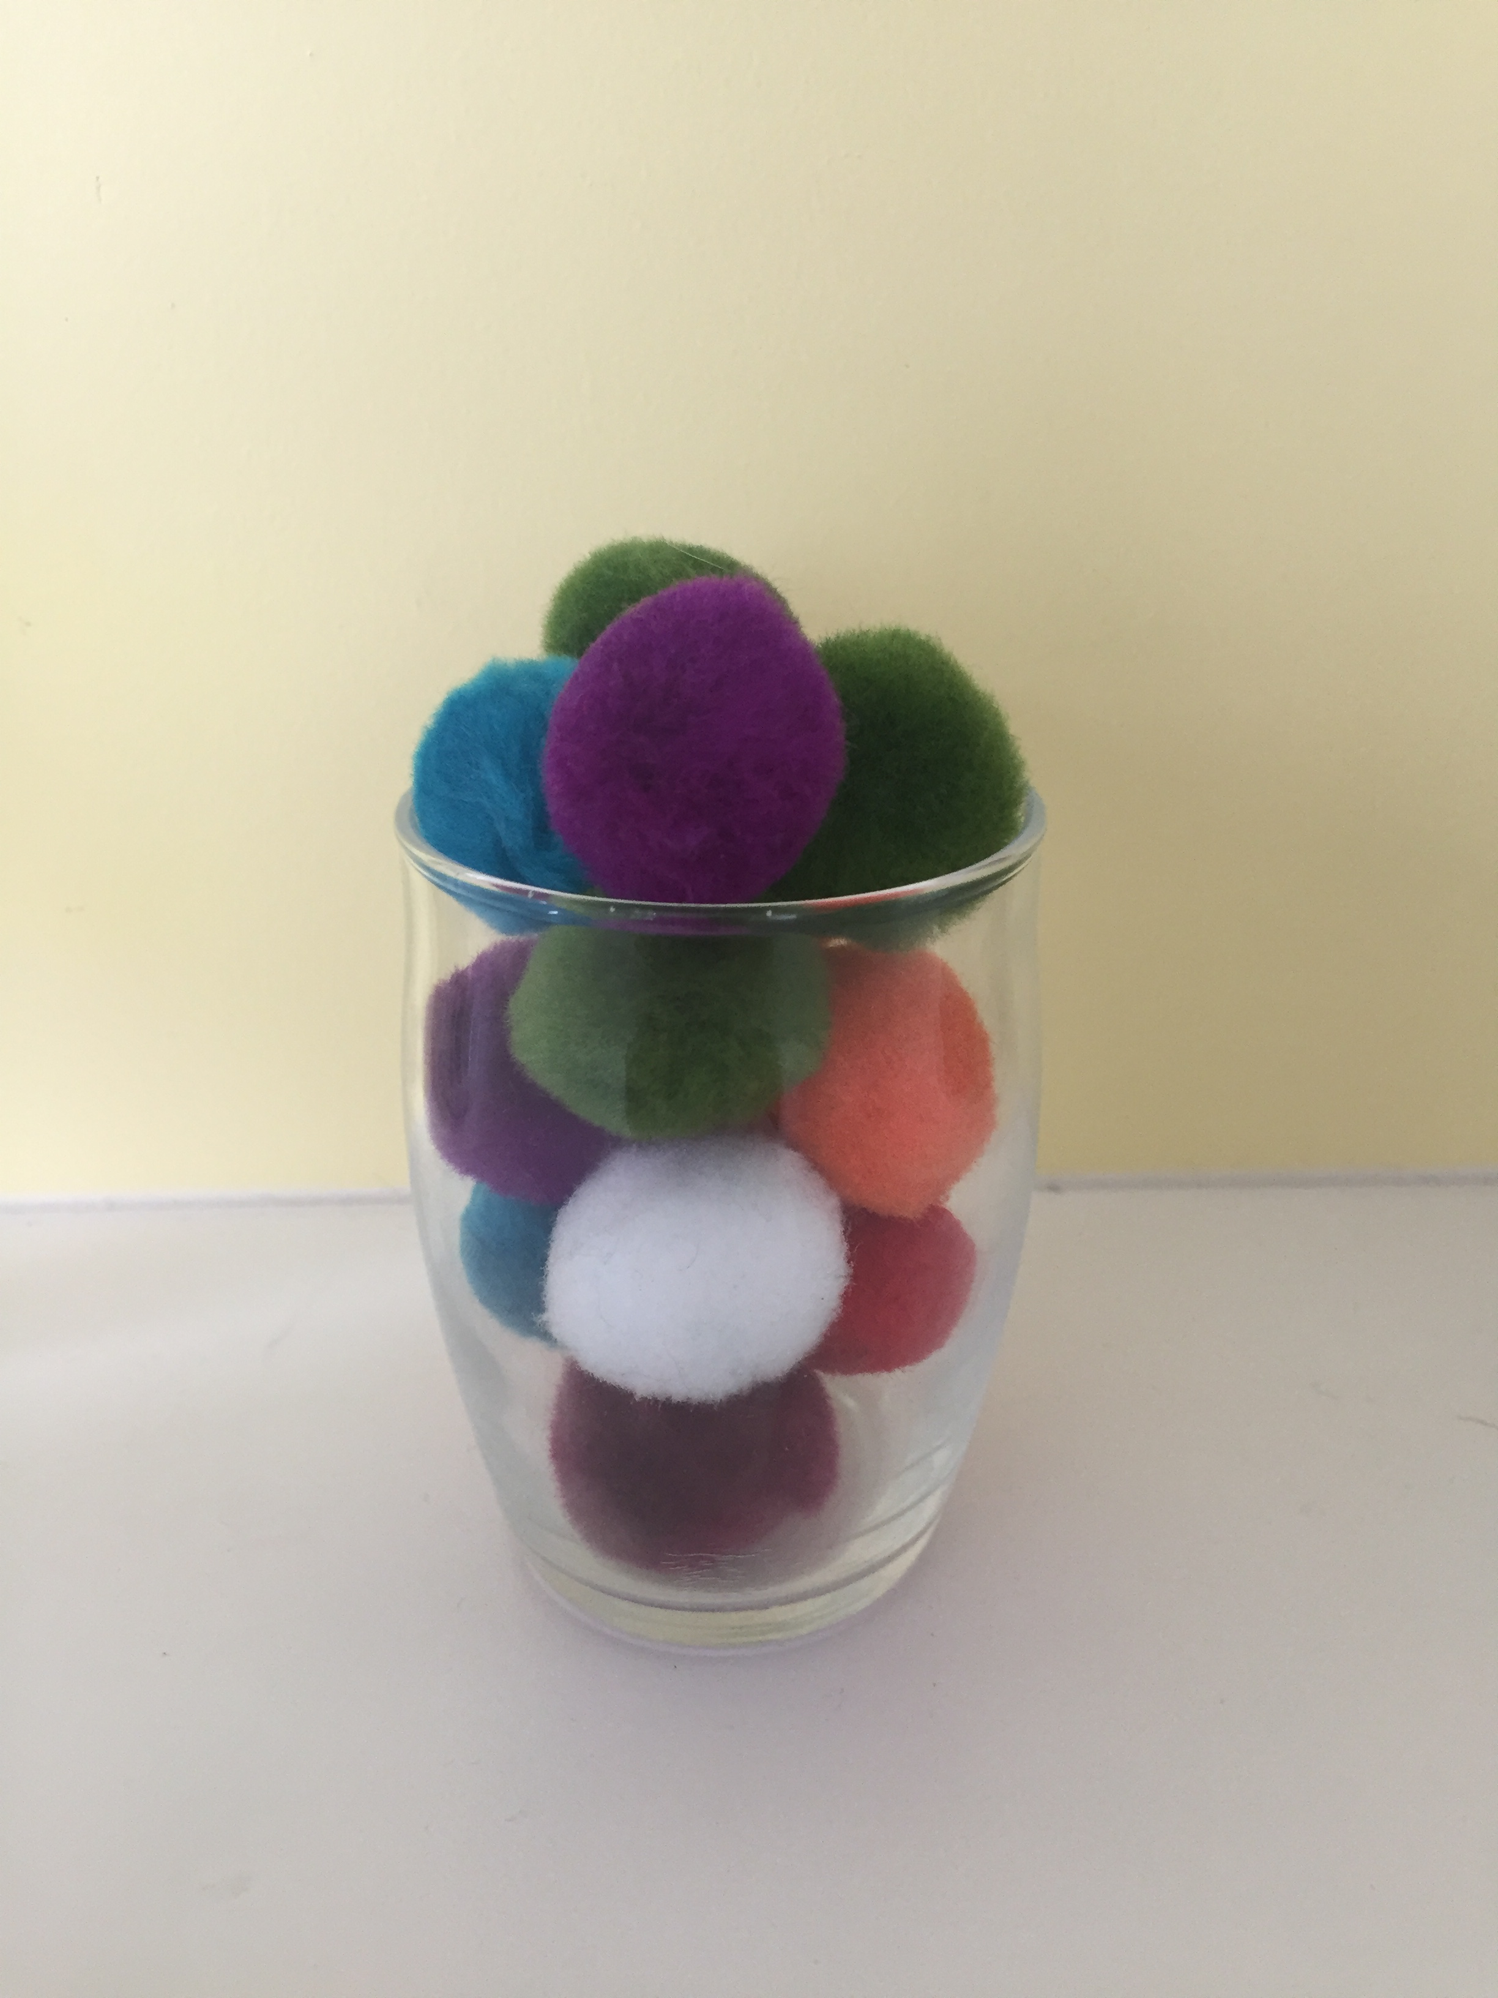
5
11
7
The Reveal

Slide 9
5
11
7
14

